Slide 1
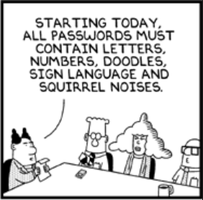
Submitting Work
Interviewer (sender) >> Bluetooth >> Supervisor (receiver) >> Dropbox >> Central Office

Slide 2
What?
Why?
When?
Who?
How?
Submitting work from the field to Central Office
Backup data, track progress
At least once per day
All interviewers and supervisors
Bluetooth, Dropbox

Slide 3
Fieldwork Flow – Submitting Work
Arrive in cluster, Identify households
Interviewers carry out module interviews, collect height/weight
Supervisor assigns households
Interviewers send data to supervisor
Interview HHs, identify eligible individuals
Team resolves structural problems
Interviewer A assigns modules to Interviewer B
Supervisor submits data to central office
Notes:
Quick look at the flow of field work from start to finish in a cluster – training will refer back to this chart regularly

Slide 4

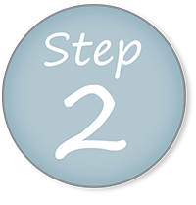
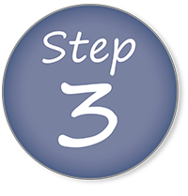
Interviewer prepares to send data, Supervisor prepares to receive data
Interviewers submit data, one at a time
Supervisor sends data to Central Office

Slide 5
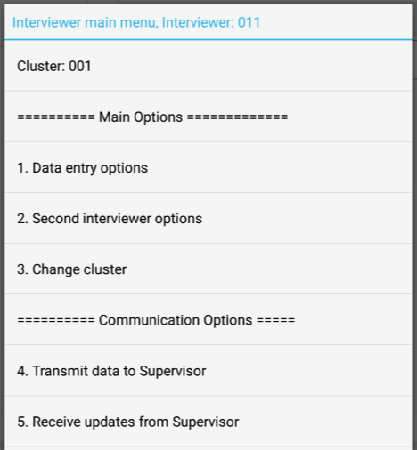

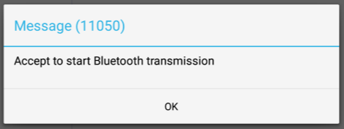
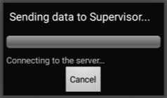
Interviewer prepares to send data
From interviewer main menu, choose option 4:

Slide 6
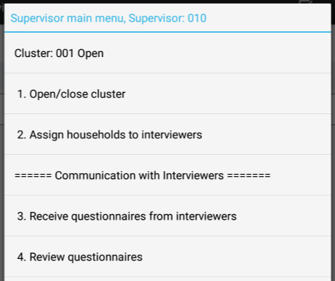

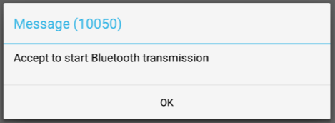
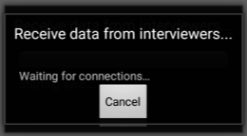
Supervisor prepares to receive data
From supervisor main menu, choose option 3:

Slide 7
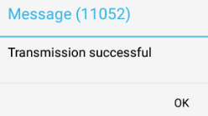
Interviewers send data
One at a time!!
Notes:
Repeat process for each interviewer, one at a time!

Slide 8
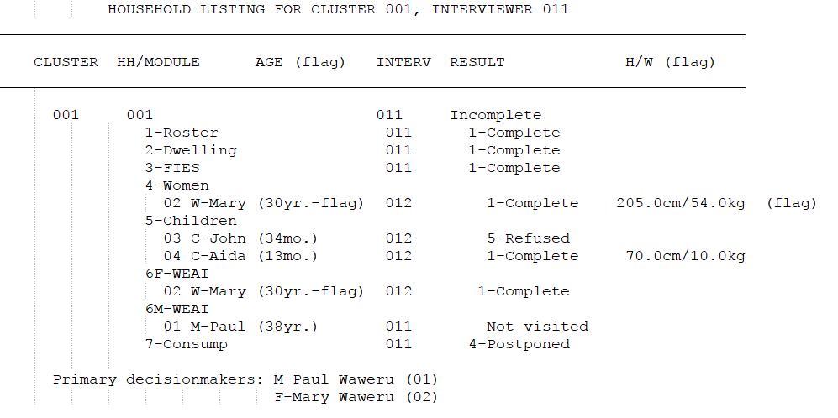
Supervisor reviews data summary
Notes:
Appears after interviewer sends data to supervisor!
Describe data summary – appears for each interviewer, and has a summary of each household and all the modules
Useful to track interviewer progress, track important data cutoffs (ages, H/W), resolve issues earlier than closing clusters

Slide 9
Supervisor reviews data summary
Cluster, Interviewer
Cluster, Household

Slide 10
Supervisor reviews data summary
Modules

Slide 11
Supervisor reviews data summary
Result codes – household and modules

Slide 12
Supervisor reviews data summary
Notes:
For women, any age ending in a 5 or 0
For children, any age divisible by 12 (i.e. months corresponding to exact years)
Weight – anything out of range in BMI scale for the age

Slide 13
Supervisor reviews data summary
Line numbers
Primary decisionmakers

Slide 14
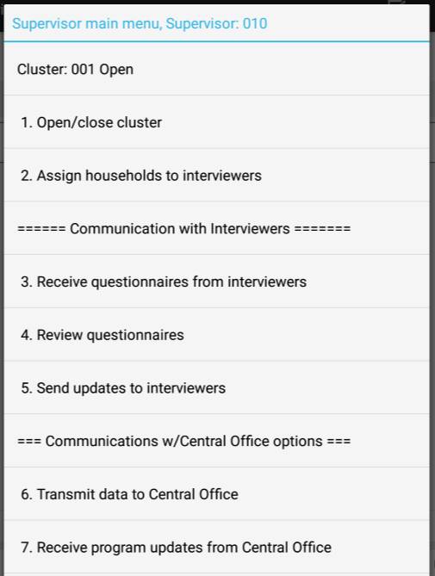

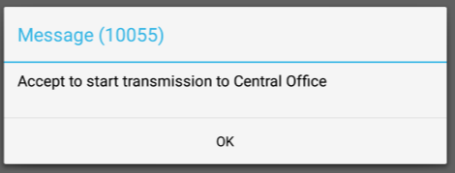
Supervisor sends team data
From supervisor main menu, choose option 6:
Notes:
GD TO DO – missing Bluetooth message box because Dropbox isn’t compatible at the moment…

Slide 15

Practice time
Each interviewer should transmit their data to the supervisor…
Supervisor should transmit the team’s data to the Central Office…

